Slide 1
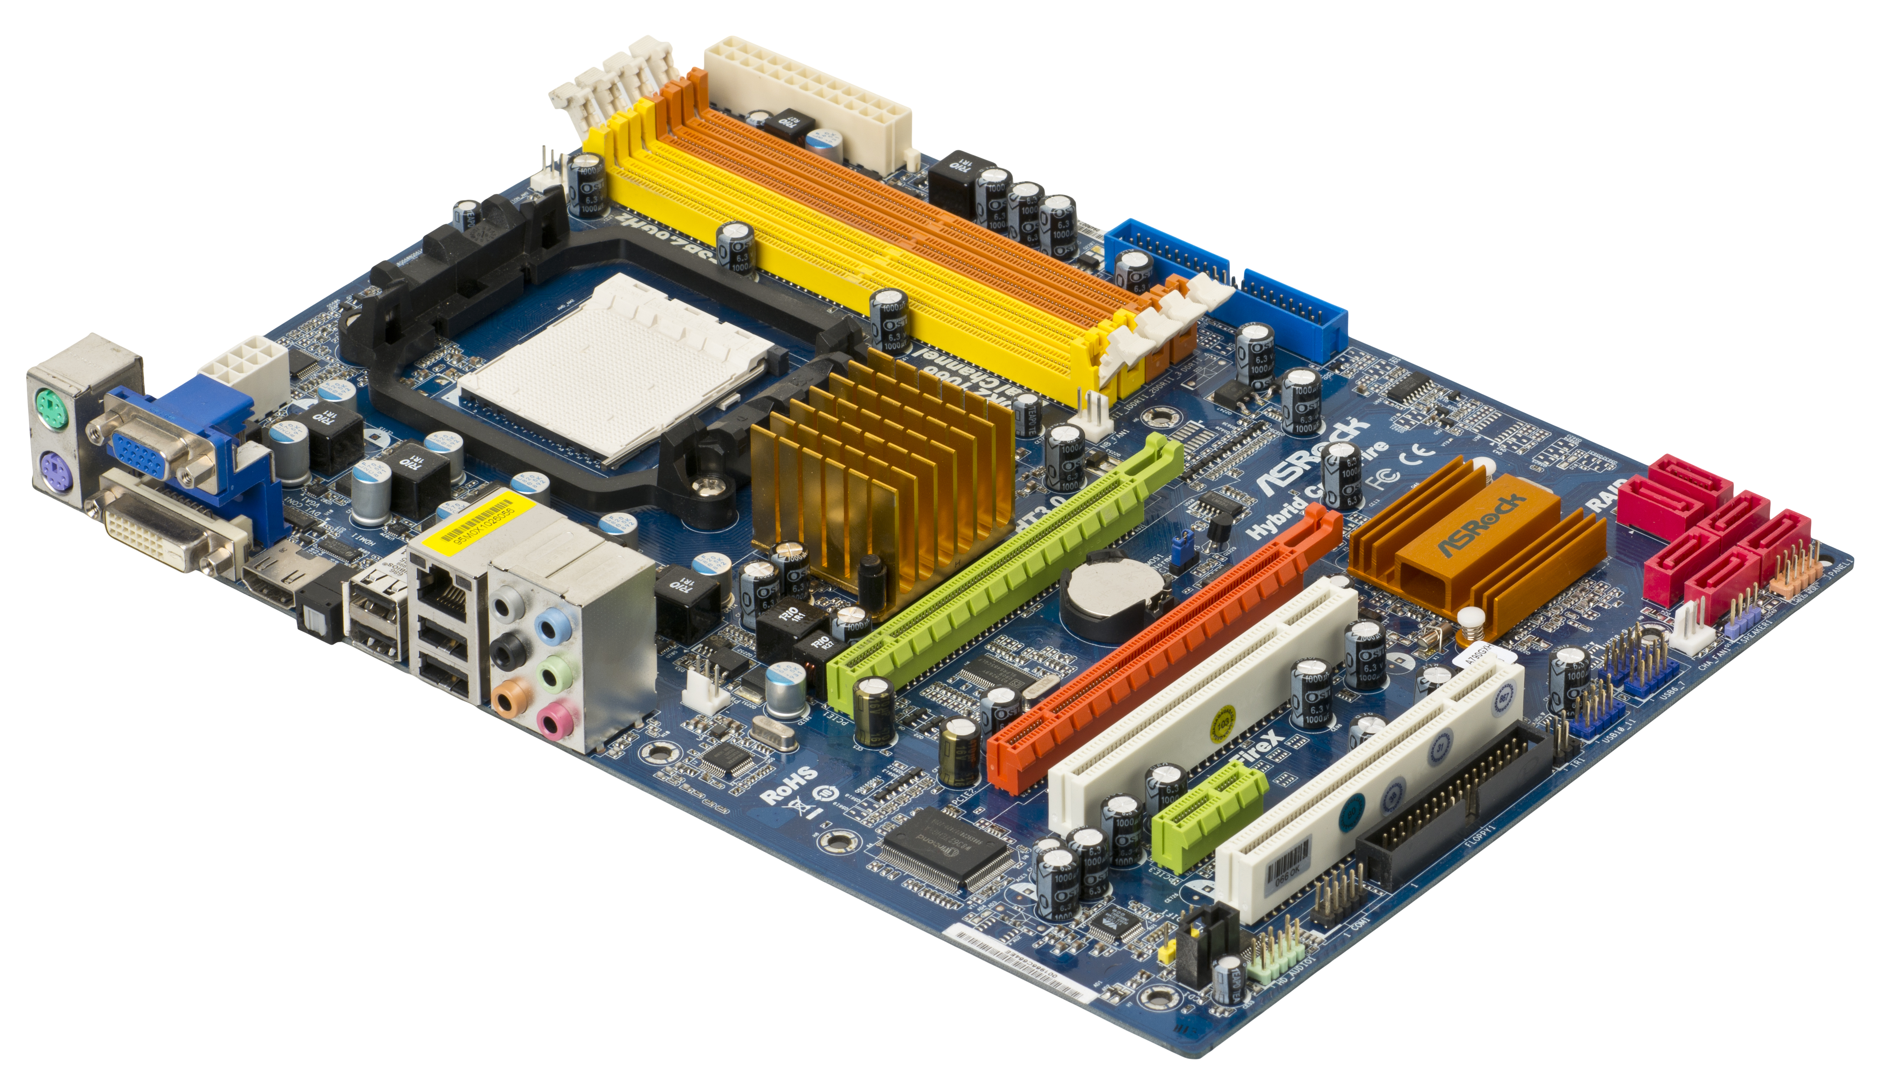
MOTHERBOARD Aizaz Ahmed BS-AI
This Photo by Unknown Author is licensed under CC BY-SA

Slide 2
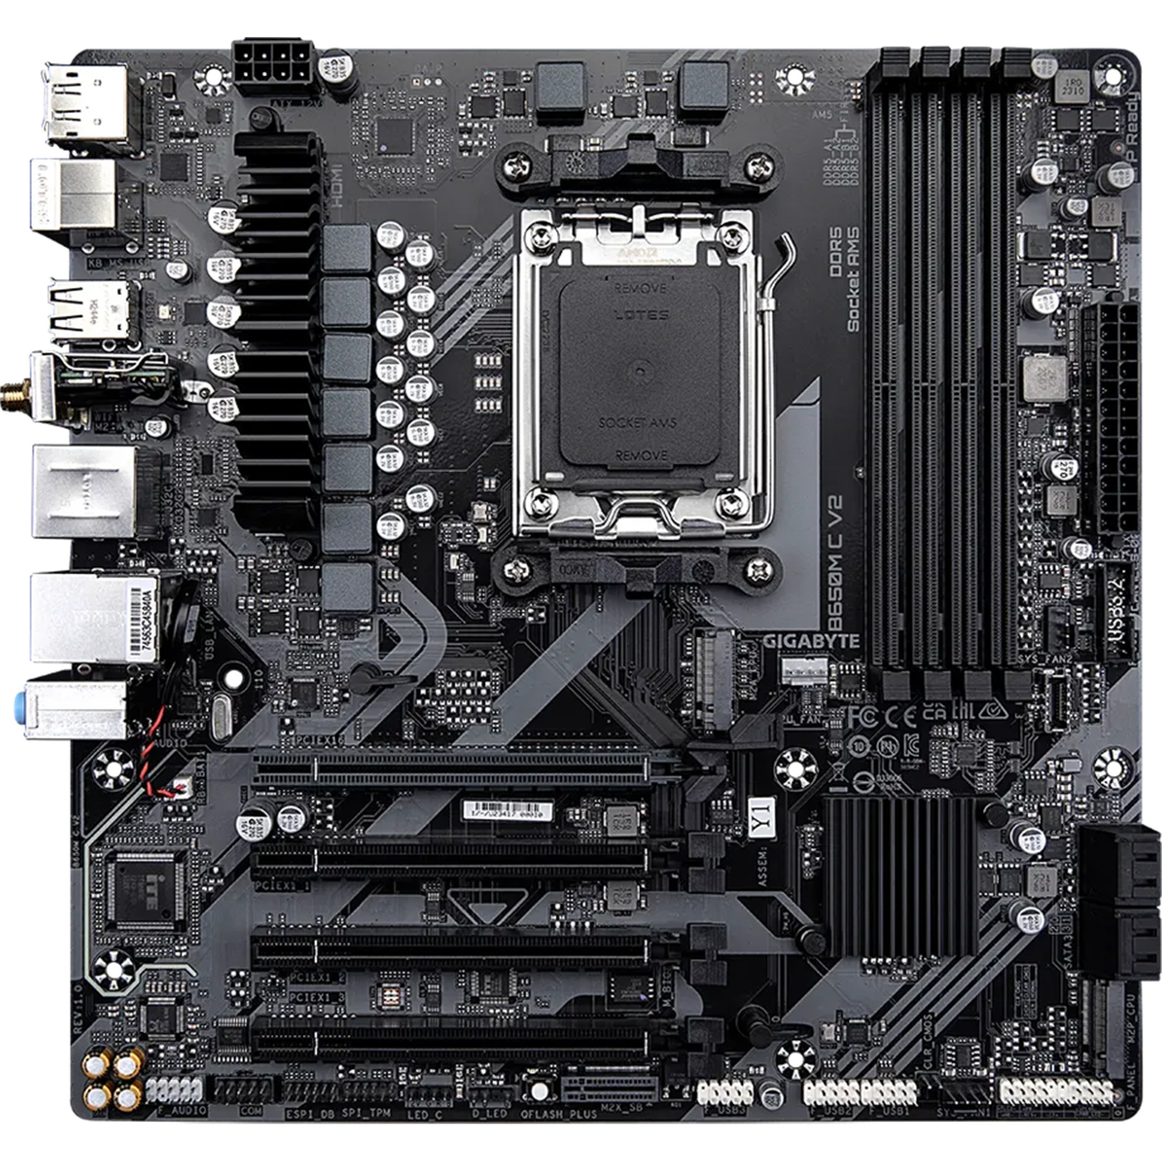
MOTHERBOARD Everything inside a computer is connected to your motherboard It allows communication between all the essential components of computer such as > RAM >CPU >storage hard drives >input and output devices

Slide 3
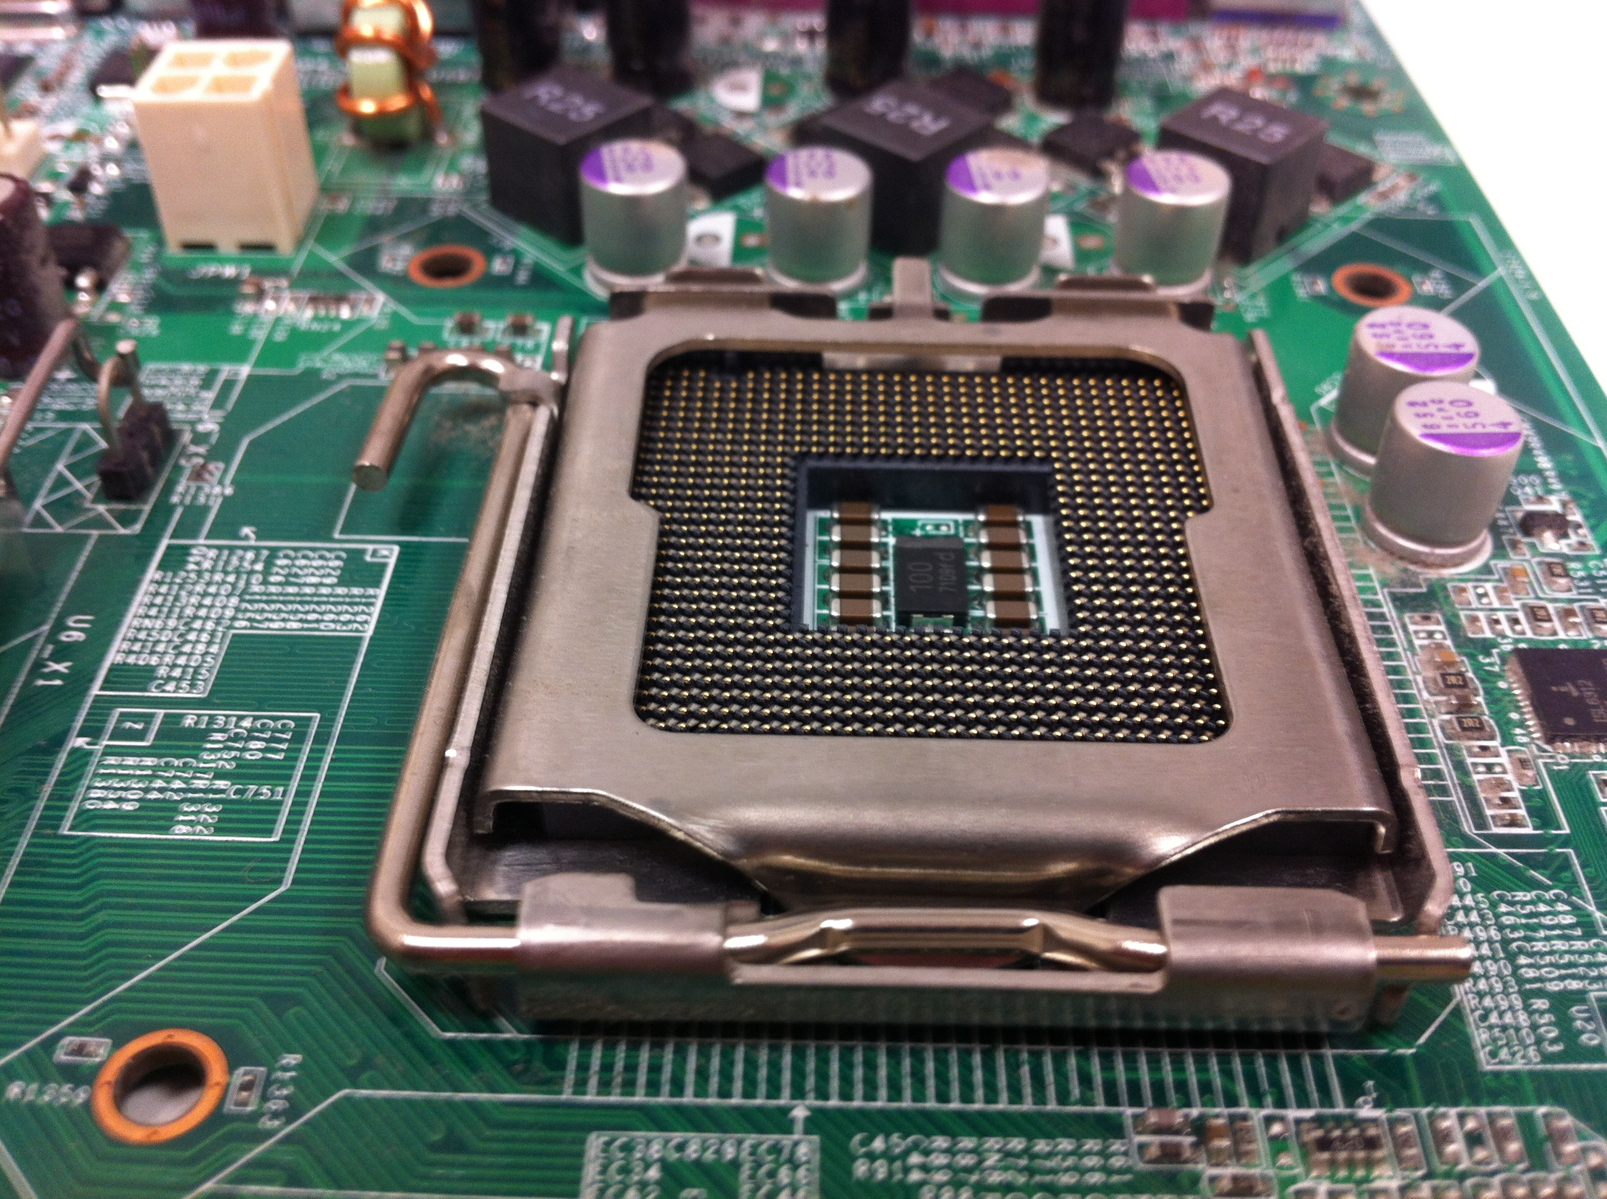
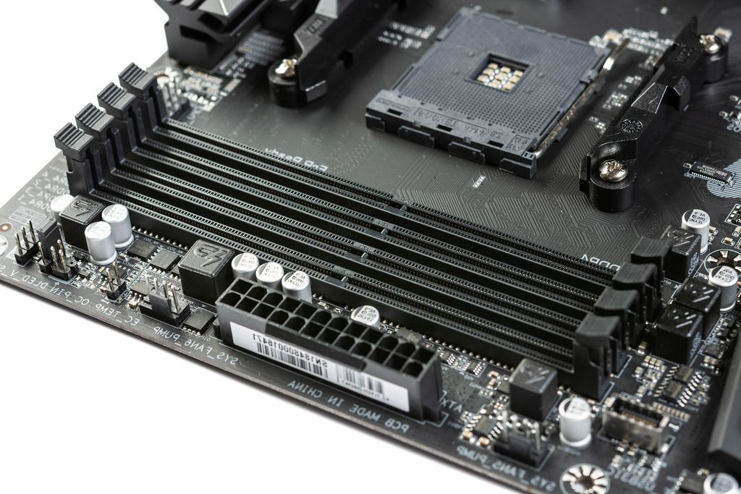
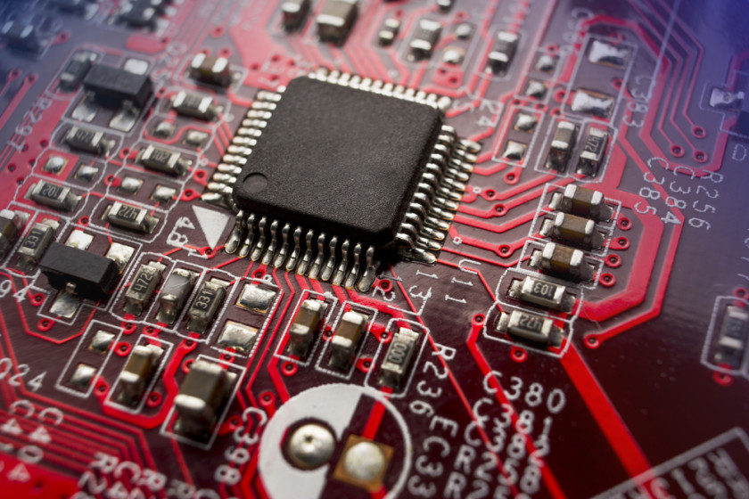
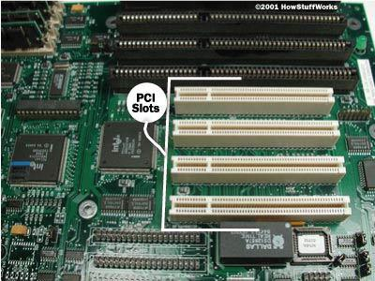
Key Components of a Motherboard
CPU Socket:
RAM Slots:
Chipset (PCH):
Expansion Slots: Storage/SATA Connectors:
I/O (input/output) Ports:
CPU SLOT
RAM SLOTS
CHIPSET (PCH)
EXPANSION SLOTS
This Photo by Unknown Author is licensed under CC BY

Slide 4
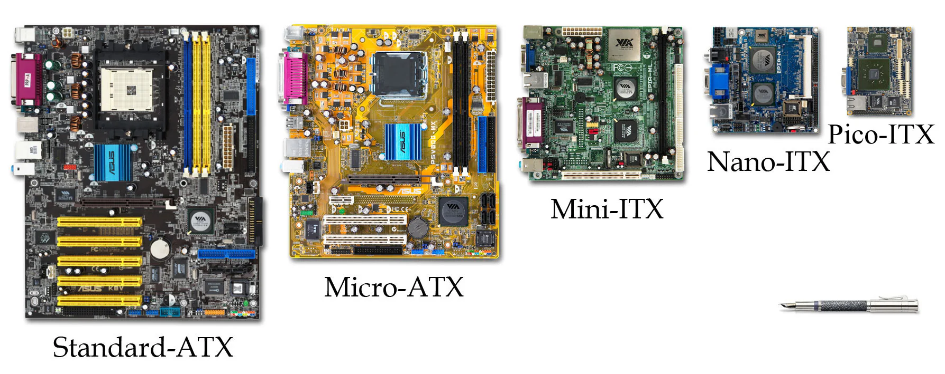
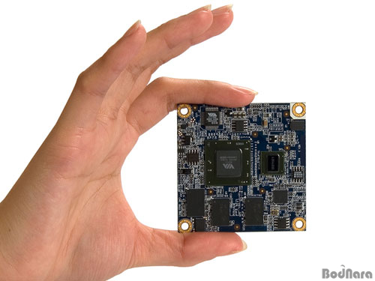
TYPES OF MOTHER BOARD
Pico-ITX 3.9 x 2.8 inch 2007
Nano-ITX is a 4.7 x 4.7 inch 2003
MINI ITX 2001 6.7—6.7 INCHES , ONE EXPANSION SLOT ONLY TWO RAM SLOTS
ATX MICRO 9.6---9.6 INCHES 1997 SMALLER IN SIZE THAN ATX CHEAPER$---LESS FETURES---SMALLER CASE
ATX (ADVANCED TECHNOLOGY EXTENDED) 1995 , NOW CONSIDERED STANDARD SIZE 9.6—12 INCHES
AT 1980 (IBM) 12—13.8 INCHES
Mobile-ITX 2.95 x 1.77 inches, one memory and one expansion slot

Slide 5
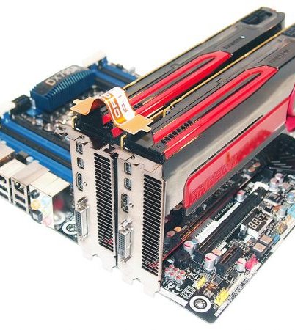
USE OF EXPANSIONS SLOTS
Graphics Cards:
Smooth AND high-resolution graphics rendering
Sound Cards:
richer sound experience for music
Network Cards:
reliable internet connectivity and faster data transfer rates
Storage Controllers:
These controllers manage multiple storage devices, optimizing data transfer and supporting advanced configurations like RAID for improved performance and redundancy.
This Photo by Unknown Author is licensed under CC BY-SA-NC

Slide 6
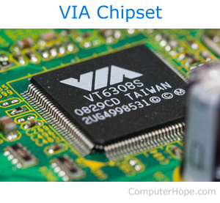




CHIPSET
THE CHIPSET IS ASILICON BACKBONE BUILT INTO THE MOTHER BOARD THAT WORKS WITH CPU .AND AIDS COMMUNICATION BETWEEN CPU ,RAM , AND EXPANSION DEVICES
IT USED TO BE DIVIDED INTO
NORTHBRIGDE-HIGH SPEED COMMUNICATION
SOUTHBRIGDE-LOW SPEED COMMUNICATION
NOW NORTHBRIDGE IS INTEGRATED INTO THE
CPU
AND SOUTH BRIDGE IS THE ONE REMAINING CHIPSET NOW CALLED PCH (PLATFORM CONTROLLER HUB)
USUALLY IS HIDDEN UNDER A HEAT SINK

Slide 7
SATA CONNECTOR
(Serial Advanced Technology Attachment)
are used to connect storage devices like hard drives, solid-state drives (SSDs)
AND HDMI (High-Definition Multimedia Interface)
M.2 SLOTS
SSDS WITH NEW M.2 COMPATIBILITY

Slide 8
Thank you

